Slide 1
Principles of Management and Applied Economics
www.hndit.com
3. Evolution of Management Thought –Part II

Slide 2
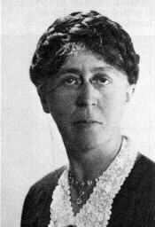
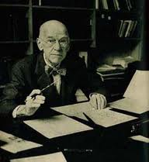
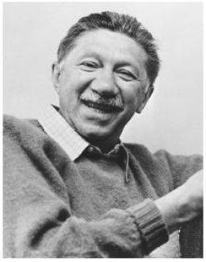
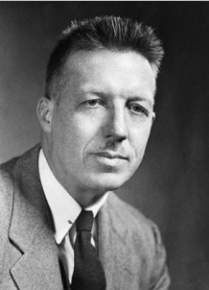
Behavioural Approach
www.hndit.com
1800 1900 1910 1920 1930 1940 1950 1960 1970 1980 1990 2000 2010
Scientific Management Theory, Administrative Management Theory and Bureaucratic Management Theory
The Behavioral School
Key Contributors to the Behavioural Approach
Mary Parker Follet
(1868 –1933)
Chester
Bernard
|(1886 –1961)
Elton Mayo
(1880 -1949)
Abraham
Maslow
(1908 -1970)
Douglas
McGregor
(1906-1964)

Slide 3
Behavioural Approach
www.hndit.com
Emphasized the importance of understanding human behaviour, needs and attitudes in the workplace as well as social interactions and group processes.
Three sub-fields of the Behavioural Approach:
Human Relations Movement
Human Resources Perspective
Behavioural Sciences Approach

Slide 4
Human Relations Movement - Elton Mayo
This school of thought was based on the idea that truly effective control comes from within the individual worker rather than from strict, authoritarian control.
The series of studies conducted by Elton Mayo and others at the Western Electric Company known as Hawthorne Studies paved the way to the development of this thought.
Recognized and directly responded to social pressures for enlightened treatment of employees.
www.hndit.com

Slide 5
Human Relations Approach- Elton Mayo Hawthorne Experiments (1924 to 1933)
www.hndit.com
Carried out at Hawthorne Plant of Western Electrical Company, USA at the beginning in order to increase the productivity
It involved,
The Illumination Experiments
Relay Assembly Test Room
The Interviewing Programme
Bank Wiring Observation Room
Hawthorne Effect

Slide 6
Hawthorne Effect
Paying special attention to employees motivates them to put greater effort into their jobs.
If special attention is paid to social factors at work and behaviour of employees within an organization, there will be a motivation to work and productivity will be improved.
www.hndit.com

Slide 7
Hawthorne Experiments: Conclusions
www.hndit.com
Man is a “social creature” that should be motivated by acknowledging his/her social needs.
The need for social relationships is more important than the physical work environment or monetary incentives.

Slide 8
Human Resources Perspective
Recognised the worker as the most important resource of the organization and should carefully address all the needs (physical, economic, social, psychological, and spiritual) of them for the enhancement of performance.
Abraham Maslow and Douglas McGregor are the best-known contributors to this perspective.
www.hndit.com

Slide 9
Behavioural Science Movement
www.hndit.com
Perceived the employee as a “Complex Man”
Hence, in order to predict and control the worker behaviour it is necessary to use the knowledge derived from social sciences such as:
Psychology, Sociology, Anthropology, Political Science, Economics, Social-psychology, etc.

Slide 10
Criticisms of Behavioural Approach
www.hndit.com
Too much emphasis on the human factor and their behaviour
Less emphasis on technology, systems and environment
Too complex to analyze and understand the human behaviour
Difficult to predict and control the human behaviour
Dominance of labour factor has created many labour problems

Slide 11
Management Science Approach
www.hndit.com
1800 1900 1910 1920 1930 1940 1950 1960 1970 1980 1990 2000 2010
Scientific Management Theory, Administrative Management Theory and Bureaucratic Management Theory
The Behavioral School
Management Science Approach

Slide 12
Management Science Approach/ Quantitative Perspective
www.hndit.com
This view distinguished for its application of mathematics, statistics, other quantitative techniques and computer applications to management decision making and problem solving.

Slide 13
Systems Approach
www.hndit.com
1800 1900 1910 1920 1930 1940 1950 1960 1970 1980 1990 2000 2010
Scientific Management Theory, Administrative Management Theory and Bureaucratic Management Theory
The Behavioral School
Management Science Approach
Systems Approach

Slide 14
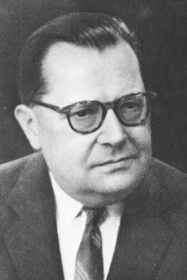
Systems Approach
www.hndit.com
Systems Approach to management views the organization as a unified, purposeful system composed of interrelated parts.
This approach gives managers a way of looking at the organization as a whole as a part of the larger environment.
(Stoner, Freeman and Gilbert 2009)
Key Contributor to the Systems Approach
Karl Ludwig von Bertalanffy (1901-1972)

Slide 15
Key Concepts of Systems Approach
www.hndit.com
System
Subsystem
System Boundary
Flow
Open System
Closed System
Entropy
Synergy

Slide 16
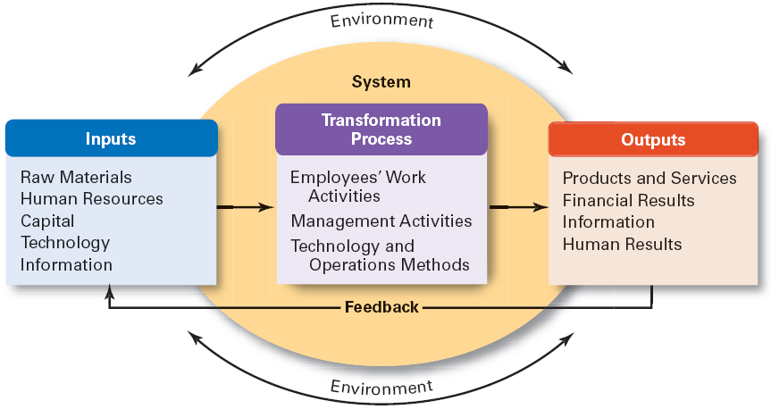
The Organization as an Open System
www.hndit.com
(Robbins and Coulter , 2010)

Slide 17
Contingency Approach
www.hndit.com
1800 1900 1910 1920 1930 1940 1950 1960 1970 1980 1990 2000 2010
Scientific Management Theory, Administrative Management Theory and Bureaucratic Management Theory
The Behavioral School
Management Science Approach
Systems Approach
Contingency Approach

Slide 18
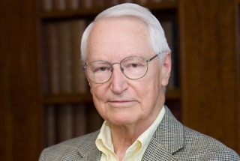
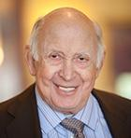
Contingency Approach
www.hndit.com
This approach suggests that there is no ‘one best way’ of managing all situations.
The view that the management technique that best contributes to the attainment of organizational goals might vary in different types of situations or circumstances.
(Stoner, Freeman and Gilbert 2009)
Key contributors to the Contingency Approach
Paul R. Lawrence Jay Lorsch
(1922-2011) (1932 to date)

Slide 19
Japanese Management Approach (1980’s)
www.hndit.com
Japan emerged as one of the super powers of world trade.
Factors contributed to the success of Japan as a Super Power
Unique management style and practices
Sense of nationality
Positive attitude towards work
Team work and high recognition of people
High priority to productivity and quality

Slide 20
Japanese Approach
www.hndit.com
The Key Concepts of Japanese Management
Participative decision-making
Bottom-up management
Lifetime employment
High level of teamwork
An atmosphere of innovative ideas
Willingness to achieve high level of quality
Lean manufacturing
Continuous improvement in organizational processes (Kai-zen)

Slide 21
www.hndit.com
William Ouchi’s investigation on comprehensive case studies of American and Japanese firms brought forward a theory called Theory Z.
In the Theory Z, Ouchi has identified Type A and Type J characteristics and introduced a middle ground framework termed as Type Z characteristics.

Slide 22
Japanese Vs American Management
www.hndit.com
Characteristic | American (A) | Japanese (J)
Employment with a firm | Usually short-term; Layoffs are quite common. | Especially in some of the large firms, it is for life. Layoffs are rare.
Evaluation and promotion of the personnel | Very fast; individuals who are not promoted rapidly often seek employment elsewhere. | Very slow; big promotions are generally not given out for years.

Slide 23
www.hndit.com
Characteristic | American (A) | Japanese (J)
Career Paths | Very specialized; people tend to stay in one area (accounting, finance, sales etc.) for their entire career. | Very general; people are rotated from one area to another and become familiar with all areas of operations
Decision Making | Carried out by the individual manager. | Carried out via group decision making.
Responsibility | Assigned on an individual basis. | Shared collectively by the group.

Slide 24
www.hndit.com
Characteristic | American (A) | Japanese (J)
Control | Very explicit; people know exactly what to control and how to do it. | Very implicit and informal; people rely heavily on trust and goodwill.
Concern for the personnel | Organization is concerned primarily with the worker’s work life only. | Organization is concerned with the whole life of the worker, business, and social.

Slide 25
Theory Z - William Ouchi
www.hndit.com
Feature
Japanese(J) American(A) J+A=Z
Employment Life time Short-term Long-term
Promotion and Evaluation Slow Rapid Moderate
Decision-making Collective Individual Team
Responsibility Collective Individual Team
Control Informal Formal Mix
Concern for worker Holistic Partial Moderate

Slide 26
Excellence in Business Approach
www.hndit.com
.

Slide 27
Characteristics of Excellence
Excellence Approach
www.hndit.com
Getting things done on time
Staying close to customers
Promoting autonomy and entrepreneurship
Maximizing productivity through people
Using hands-on approach to managing
Doing what the company knows best
Maintaining a simple, lean organizational structure
Promoting both centralization and decentralization simultaneously
(Peter and Waterman, 1990)

Slide 28
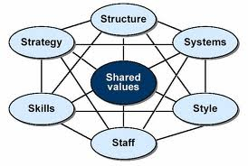
McKinsey 7 S Framework
Excellence Approach
www.hndit.com

Slide 29
Model of MBWA
www.hndit.com
Leadership
(MBWA)
Care for Customers
Constant Innovations
People
Tom Peters and Nancy Austin (A Passion for Excellence,1985)

Slide 30
www.hndit.com
Evolving Contemporary Management Practices
Learning Organisations and Knowledge Management
Supply Chain Management
Quality Management
Diversity Management
Technology Management / E - Management
Innovation Management
Global Business Management

